Slide 1

实证资产定价:DGTW
张欣然
中央财经大学金融学院
邮箱：zhangxinran@cufe.edu.cn

Slide 2
Measuring Mutual Fund Performance with Characteristic-Based Benchmarks
JF1997
Kent Daniel – Northwestern University
Mark Grinblatt – University of California LA
Sheridan Titman – University of Texas at Austin
Russ Wermers – University of Colorado at Boulder
Notes:
Thanks. So the next one hour, I am going to talk about volatility and cross-section of returns. This is a joint work with Andrew Ang, Bob Hodrick and Yuhang Xing.
Recently, we have seen quite few paper discussing volatilities. For me and my coauthors, we always look at things from the asset pricing perspective. And we start to think, what is the implication for an investor who can allocate his money among firms with different volatilities? That’s when we start to write this paper.
Stochastic volatility

Slide 3




作者

Slide 4
Kent Daniel
Jean-Marie Eveillard/First Eagle Investment Management Professor of Business in the Finance Division at Columbia Business School
1996 to 2006, Kellogg School of Management at Northwestern University, John and Helen Kellogg Distinguished Professor of Finance
2004 to 2010, the Quantitative Investment Strategies group at Goldman Sachs Asset Management
Behavioral finance and asset pricing
Notes:
http://www.kentdaniel.net/research.php

Slide 5
Mark Grinblatt
Ph.D. Economics, 1982, Yale University
UCLA Anderson School of Management in 1981, Distinguished Professor Emeritus, Finance
Asset pricing, derivatives, performance evaluation, asymmetric information, security design, event studies, behavioral finance and household finance

Slide 6
Sheridan Titman
University of Texas at Austin, McCombs School of Business
Additional Titles: Professor; Director, Energy Management and Innovation Center
Industry Areas: Energy, Investment Banking, Investment Management, Real Estate
Research Areas: Accounting - Government, Finance - Corporate, Investments, Real Estate

Slide 7
Russ Wermers
University of Maryland, Robert H. Smith School of Business
Paul J. Cinquegrana ’63 Endowed Chair in Finance
Director, Center for Financial Policy
Ph.D., University of California, Los Angeles
Efficiency of securities markets, as well as the role of institutional investors in setting stock prices

Slide 8
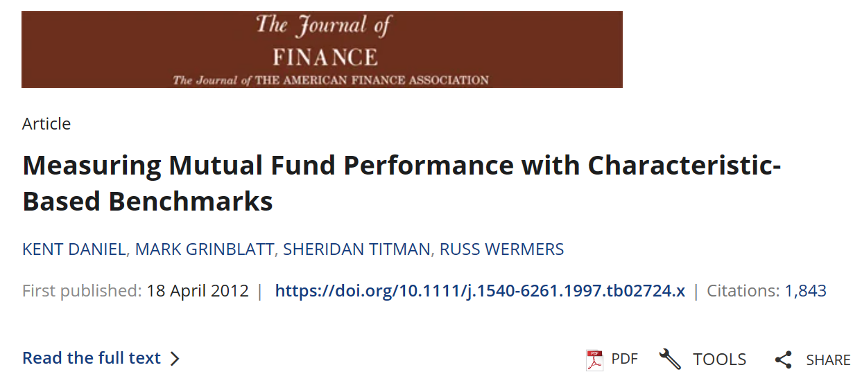
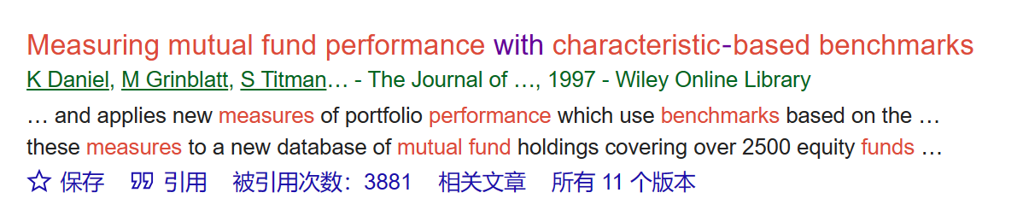
出版细节
Google Scholar 引用: 3,881

Slide 9
Abstract
Develops new measures of portfolio performance which use benchmarks based on the stock characteristics
The benchmarks are constructed from the returns of 125 passive portfolios that are matched with market capitalization, book-to-market, and prior-year return
“Characteristic Timing” and “Characteristics Selectivity” measures are developed to detect whether portfolio managers successfully time their portfolio and can select stocks
Mutual fund holding data covering 2500 equity funds from 1975 -1994
Mutual funds exhibit some selectivity ability, but no timing ability

Slide 10
Motivation
Over one trillion dollars are invested in actively managed equity mutual funds.
Assume the fees and expenses of these funds average about 1% of assets (conservative estimate), the total costs generated by this industry exceed $10 billion per year
Whether mutual funds can systematically pick stocks that allow them to earn back a significant fraction of the fees and expenses that they generate.

Slide 11
Previous literature
Mutual funds do not have significant stock-picking abilities
  Jensen (1968), Malkiel (1995), Gruber (1996)
Persistence in mutual fund performance
  Grinblatt and Titman (1992), Hendricks, Patel, and Zeckhauser (1993), and Goetzmann and Ibbotson (1994)
  Survival bias or benchmark errors
Key difference: how to assess the performance of mutual funds
  Actual returns that investors realize from holding the funds
  Examine the performance of the individual stocks held by funds Grinblatt and Titman (1989a, 1993)

Slide 12
This paper
New dataset: free from survivorship bias
New performance measure: directly matching the characteristics of the component stocks of the portfolio
  Contrasted with the alternative factor approach: (1) Forms factor portfolios based on characteristic-sorted stocks. (2) Return on these factor portfolios are then used as regressor in a traditional multifactor regression model.
  The characteristics approach could decompose fund returns into the components of Average Style (AS), Characteristic Selectivity (CS), and Characteristic Timing (CT).

Slide 13
Mutual Fund Data
Quarterly equity holdings for all equity mutual funds between December 31, 1974 and December 31, 1994
Over 5,000 funds: exclude sector funds, bond, and preferred funds, and any fund with an investment objective that is not oriented to general equity.
Remaining: 2500 funds

Slide 14
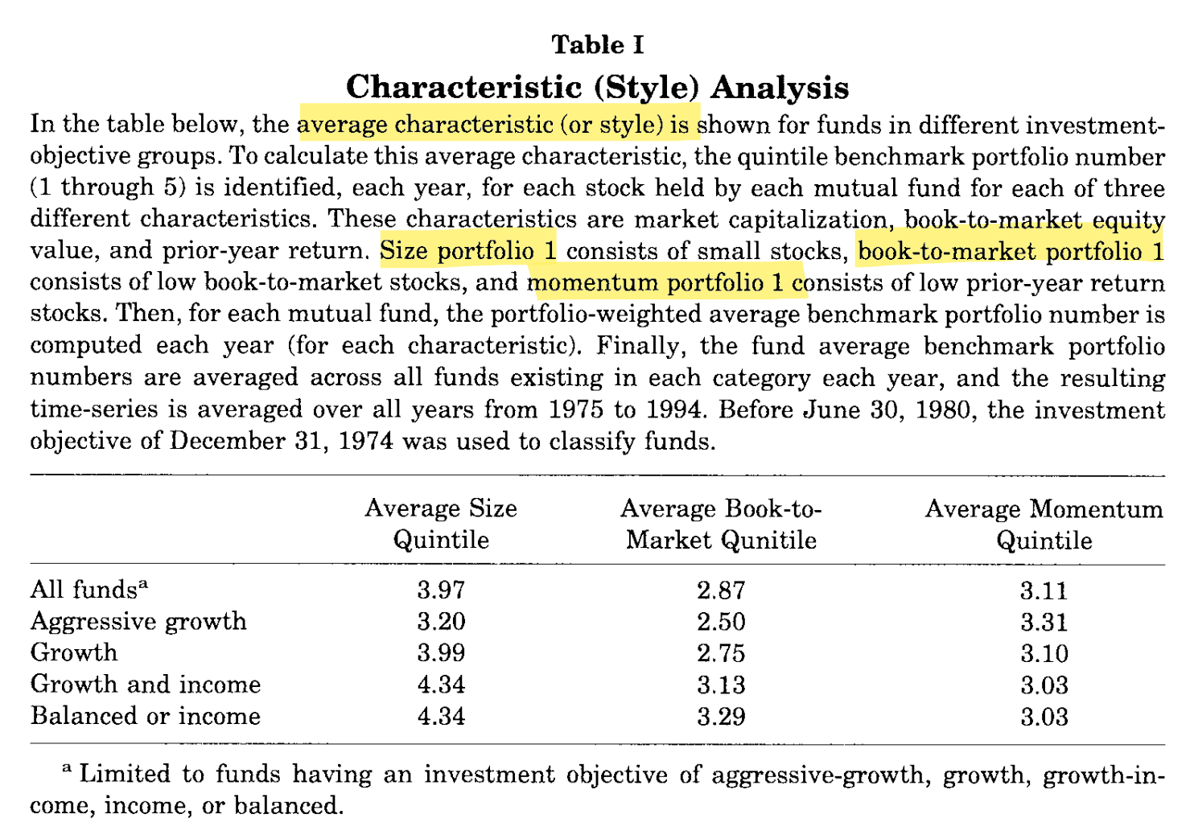

Slide 15
Performance-Evaluation Method
For each fund, we first calculate the hypothetical monthly returns that would be generated by buying the number of shares of each CRSP stock held by the fund on the first day of each quarter and holding the portfolio until the first day of the following quarter.
Performance = Hypothetical fund returns – benchmark portfolios
  The characteristic-based approach that uses benchmark portfolios constructed to match the characteristics of the stocks held by a mutual fund. (CS, CT, and AS measures)
  The GT measure which uses the past portfolio weights of a fund as a benchmark
  Jensen Measure 1: Chart (1997) four factor
  Jensen Measure 2: CRSP value-weighted index

Slide 16
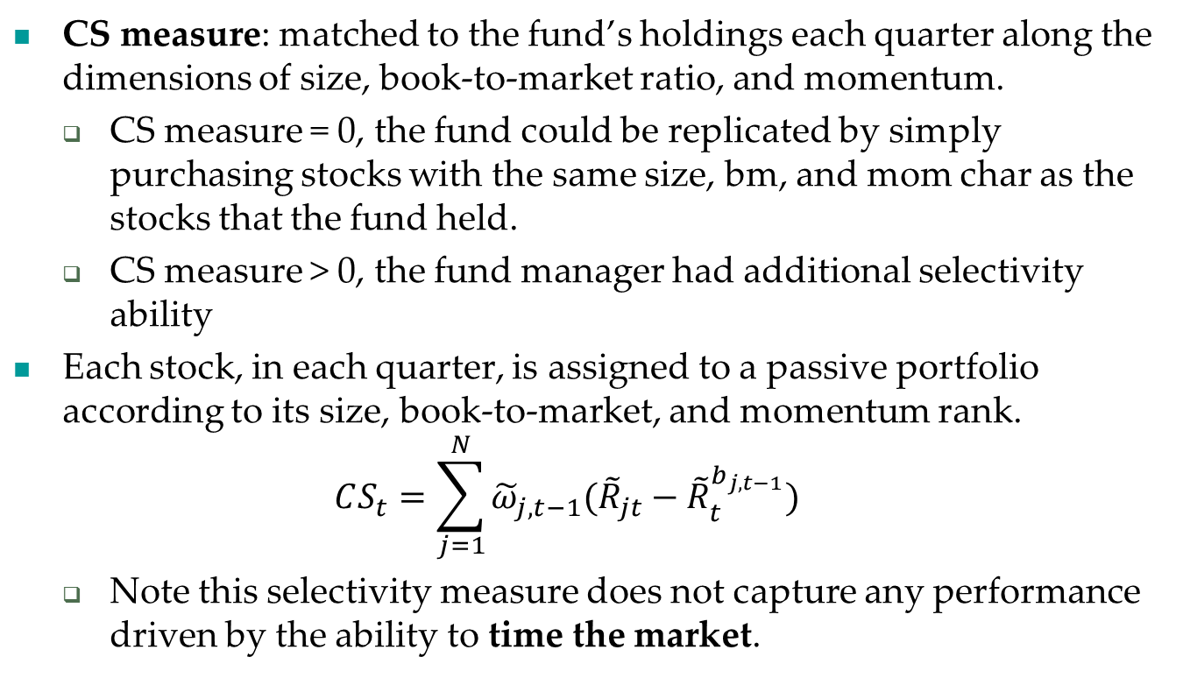
Performance-Evaluation Method
CS measure: matched to the fund’s holdings each quarter along the dimensions of size, book-to-market ratio, and momentum.
  CS measure = 0, the fund could be replicated by simply purchasing stocks with the same size, bm, and mom char as the stocks that the fund held.
  CS measure > 0, the fund manager had additional selectivity ability
Each stock, in each quarter, is assigned to a passive portfolio according to its size, book-to-market, and momentum rank.
  $$CS_{t}=\sum_{j=1}^{N}{{\tilde{ω}}_{j,t−1}({\tilde{R}}_{jt}−{\tilde{R}}_{t}^{b_{j,t−1}})}$$
  Note this selectivity measure does not capture any performance driven by the ability to time the market.

Slide 17
125 benchmark portfolios
In July 1972, and in each following July, we place every common stock listed on NYSE, AMEX, and Nasdaq into portfolios.
Data Criteria: We require that COMPUSTAT data be available for at least two years prior to the inclusion of the firm in the sample, and the firm have market value data available on CRSP at the end of December, and the end of June preceding the formation date. We require that firm have at least six monthly returns available on CRSP in the 12 months preceding the formation date. The portfolios are all value-weighted, buy-and-hold portfolios.
Triple-sort 125 portfolios based on each firm’s size, book-to-market ratio, and momentum.

Slide 18
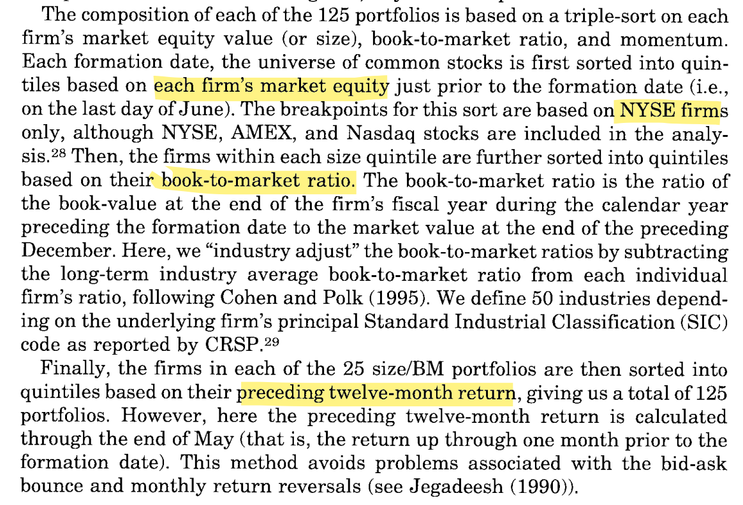
125 benchmark portfolios

Slide 19
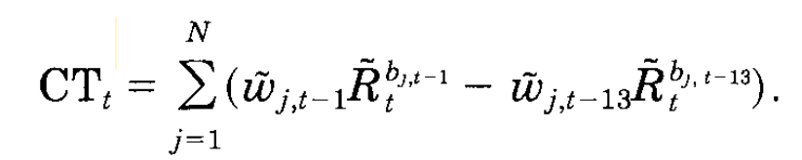
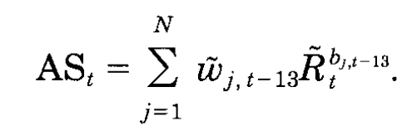
Performance-Evaluation Method
CT: measure a fund manager’s success at timing the different investment styles, introduce a CT measure:
AS: to measure the returns earned by a fund due to that fund’s tendency to hold stocks with certain characteristics.

Slide 20
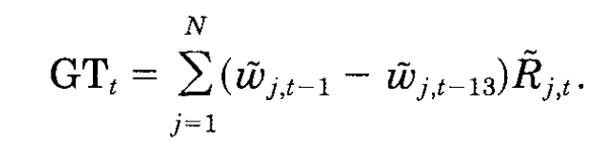
Performance-Evaluation Method
GT Measure of Performance
Carhart Measure

Slide 21
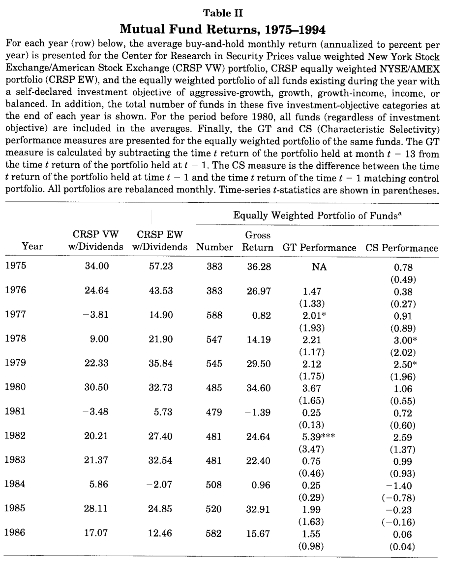
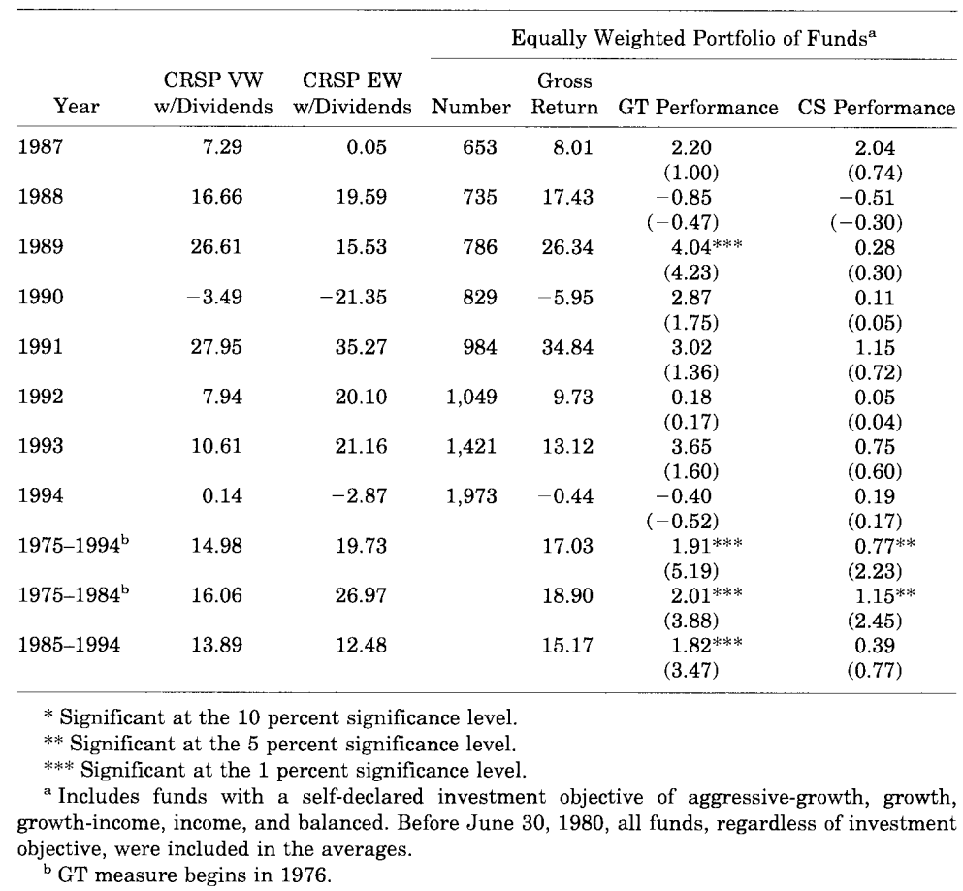

Slide 22
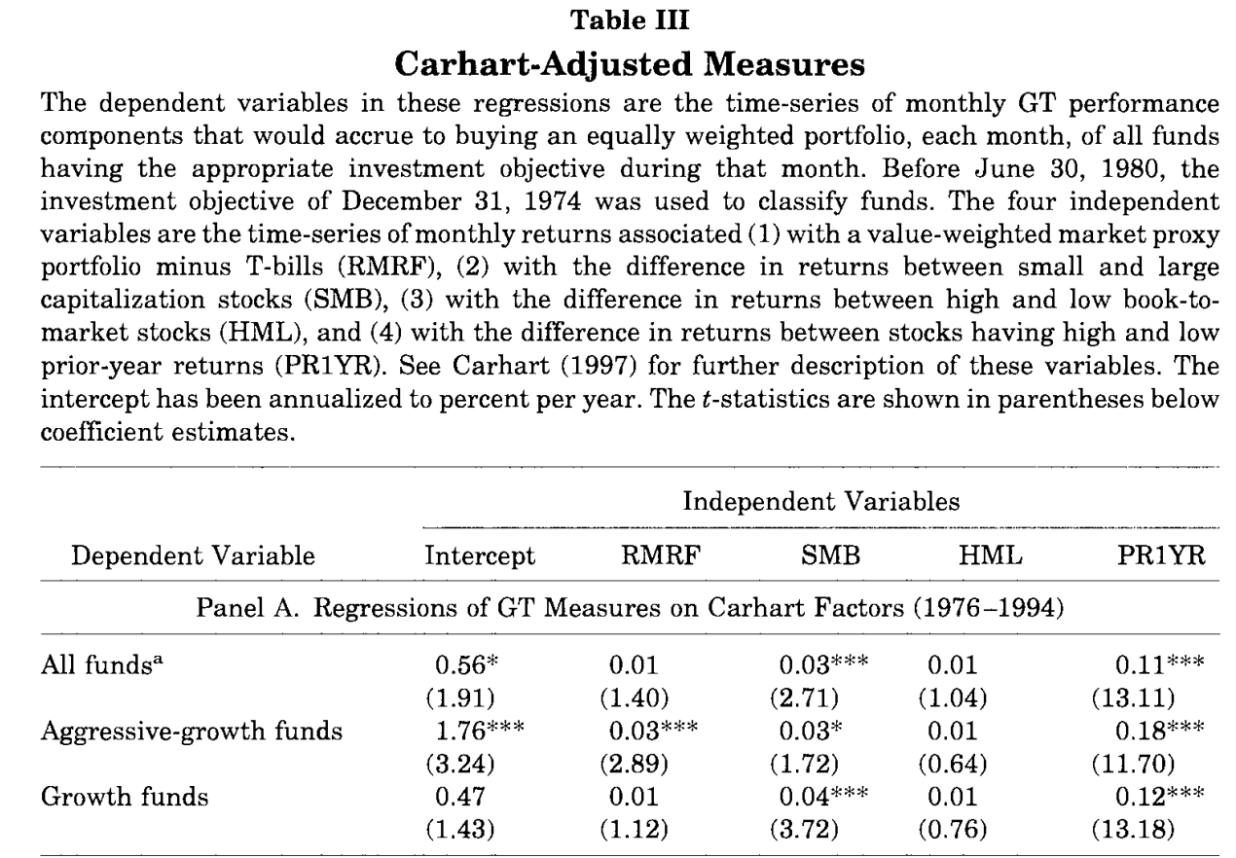

Slide 23
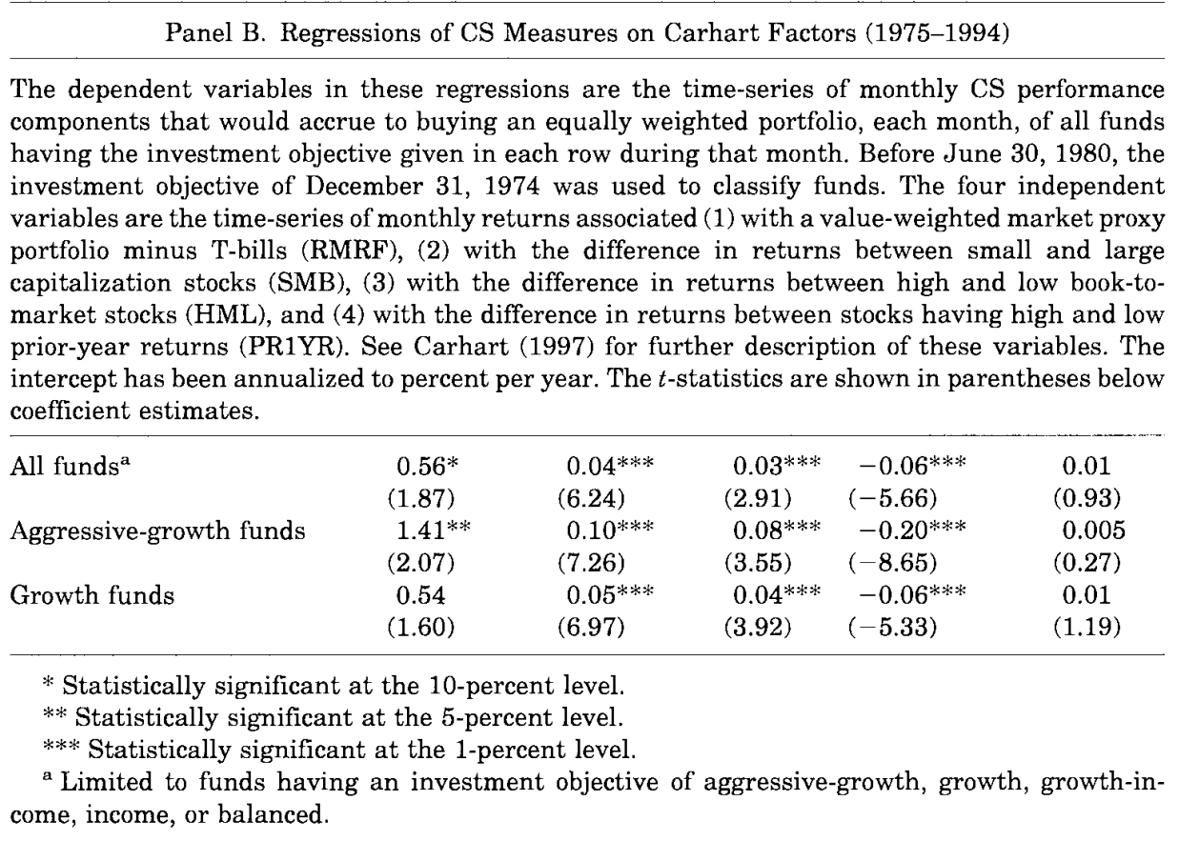

Slide 24
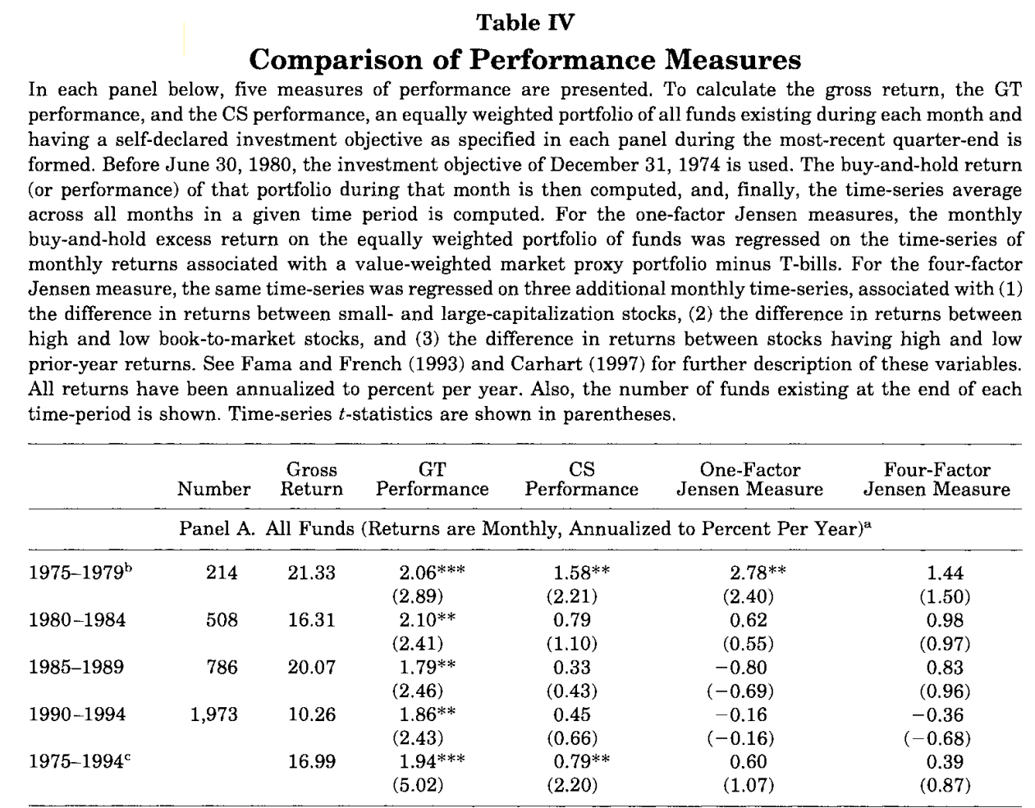

Slide 25
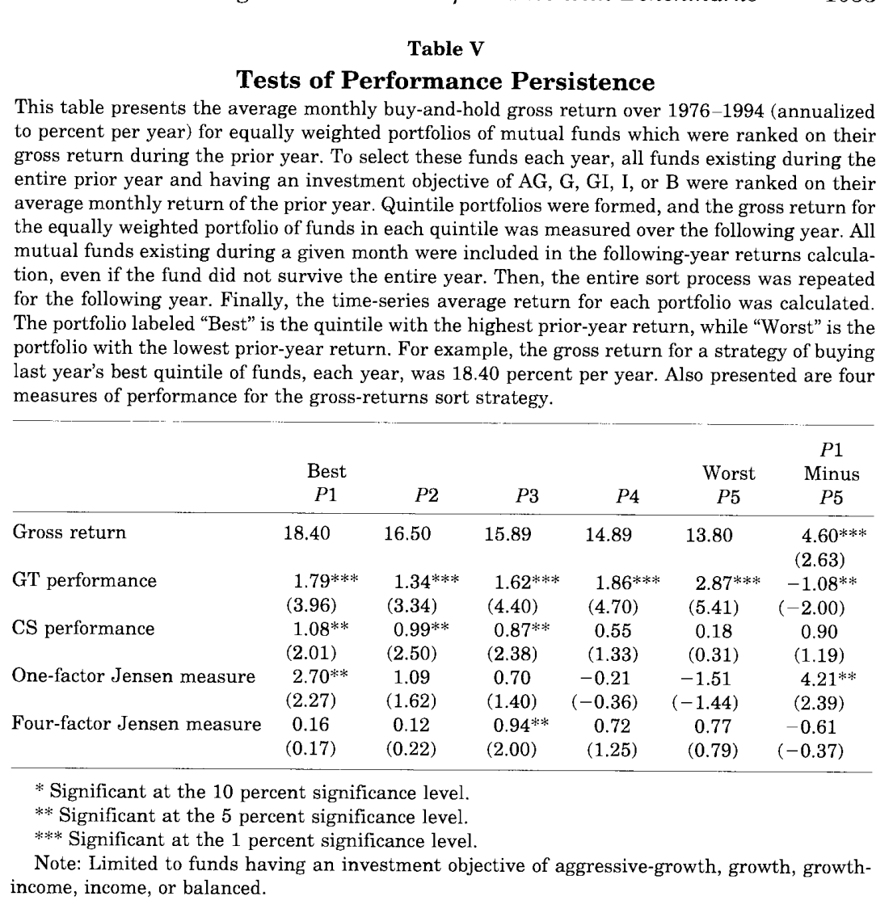

Slide 26
